Slide 1
Applying Psychology PSY2117 Week 2: Open Science I
Lecturer: Dr Reshanne Reeder

Slide 2
Lecture structure
What does it take to be a scientist?
The scientific method: in theory and practice
Fraudsters, follies, and bad science
The replication crisis
Intro to open science principles

Slide 3
Thinking like a Scientist
What does it take to be a scientist?
Mentimeter exercise: https://www.menti.com/alafqrycxxdg
Notes:
What does a scientist need to know how to do? Certain skillset? Credentials?

Slide 4
Thinking like a Scientist
The Scientific Method
Question
Notes:
You have to be doing this experiment for some reason. You want to find something out. You can’t just start an experiment with no idea about why you’re doing it (except this can actually happen, which is very bad practice). You will learn to search for the question in any paper you read, and if it’s not clearly stated, you will be able to formulate it with a bit of thinking.

Slide 5
Thinking like a Scientist
The Scientific Method
Question: Is the Earth round or flat?
Notes:
You have to be doing this experiment for some reason. You want to find something out. You can’t just start an experiment with no idea about why you’re doing it (except this can actually happen, which is very bad practice). You will learn to search for the question in any paper you read, and if it’s not clearly stated, you will be able to formulate it with a bit of thinking.

Slide 6
Thinking like a Scientist
The Scientific Method
Question: Is the Earth round or flat?
Hypothesis
Notes:
You don’t know the answer to your question. If it was obvious, you wouldn’t be doing the experiment. However, you should have an idea of which way you’re leaning.

Slide 7
Thinking like a Scientist
The Scientific Method
Question: Is the Earth round or flat?
Hypothesis: The Earth is flat.
Notes:
You don’t know the answer to your question. If it was obvious, you wouldn’t be doing the experiment. However, you should have an idea of which way you’re leaning.

Slide 8
Thinking like a Scientist
The Scientific Method
Question: Is the Earth round or flat?
Hypothesis: The Earth is flat.
Prediction
Notes:
It’s easy enough to hypothesize that the Earth is flat, but what prediction can you make that will give you irrefutable proof of this?

Slide 9
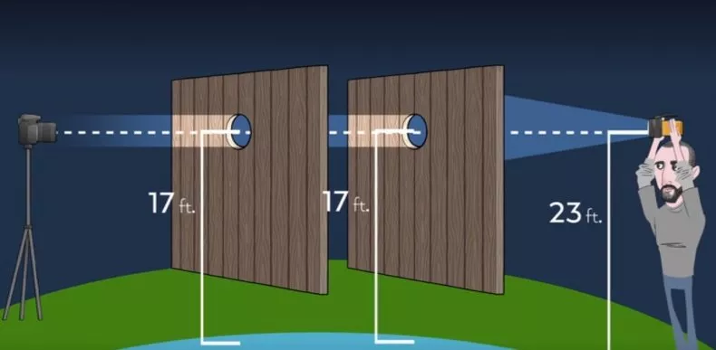
Thinking like a Scientist

Slide 10
Thinking like a Scientist
The Scientific Method
Question: Is the Earth round or flat?
Hypothesis: The Earth is flat.
Prediction: You can shine a light straight through two holes a distance apart from each other, from the same height as the holes (flat earth)
Notes:
It’s easy enough to hypothesize that the Earth is flat, but what prediction can you make that will give you irrefutable proof of this?

Slide 11
Thinking like a Scientist
The Scientific Method
Question: Is the Earth round or flat?
Hypothesis: The Earth is flat.
Prediction: You can shine a light straight through two holes a distance apart from each other, from the same height as the holes (flat earth)
Test
Notes:
Make your method as specific as possible so anyone can replicate this. Before you conduct your research, make sure your design is so rigorous that you cannot doubt your result as a mistake on your part. Double check with those Round Earthers that your experiment is flawless, and that whatever result you get, you’ll take, because it will be the truth.

Slide 12
Thinking like a Scientist
The Scientific Method
Question: Is the Earth round or flat?
Hypothesis: The Earth is flat.
Prediction: You can shine a light straight through two holes a distance apart from each other, from the same height as the holes (flat earth)
Test: https://www.youtube.com/watch?v=EBtx1MDi5tY
Notes:
Make your method as specific as possible so anyone can replicate this. Before you conduct your research, make sure your design is so rigorous that you cannot doubt your result as a mistake on your part. Double check with those Round Earthers that your experiment is flawless, and that whatever result you get, you’ll take, because it will be the truth.

Slide 13
Thinking like a Scientist
The Scientific Method
Question: Is the Earth round or flat?
Hypothesis: The Earth is flat.
Prediction: You can shine a light straight through two holes a distance apart from each other, from the same height as the holes (flat earth)
Test: https://www.youtube.com/watch?v=EBtx1MDi5tY
Analysis
Notes:
Take whatever you get and go from there. This is very important – if your results aren’t what you expected, if they make no sense to you, ask yourself why you are confused. If you did all the steps correctly, you must accept the results. You can’t ignore them. You said this experiment was flawless. No excuses. No take backsies.

Slide 14
Thinking like a Scientist
The Scientific Method
Question: Is the Earth round or flat?
Hypothesis: The Earth is flat.
Prediction: You can shine a light straight through two holes a distance apart from each other, from the same height as the holes (flat earth)
Test: https://www.youtube.com/watch?v=EBtx1MDi5tY
Analysis: “We must have done something wrong”

Slide 15
Thinking like a Scientist
Question: Is the Earth round or flat?
Hypothesis: The Earth is flat.
Prediction: You can shine a light straight through two holes a distance apart from each other, from the same height as the holes (flat earth)
Test: https://www.youtube.com/watch?v=EBtx1MDi5tY
Analysis: “We must have done something wrong”
Conclusion: “Long live Flat Earth”

Slide 16
Thinking like a Scientist
What does it take to be a scientist?
Notes:
So going back to what it takes to be a scientist. You don’t need a degree to use the scientific method. But it often takes years of work to undo your biases, unravel your non-scientific thoughts, and flip that switch. You have to be willing to change your mind based on the evidence.

Slide 17
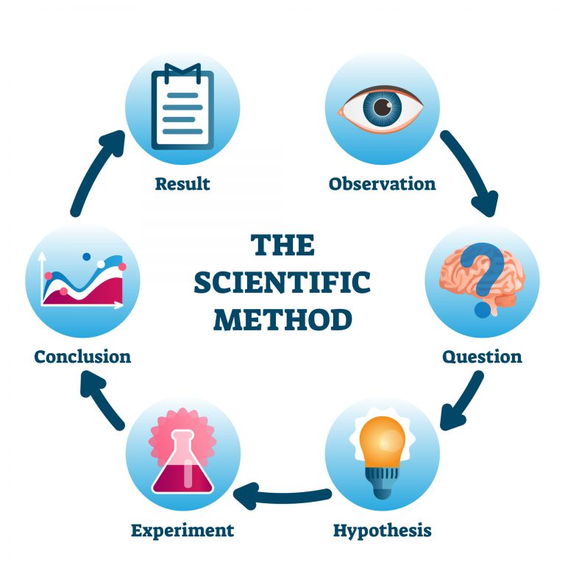
A short history…
How science is supposed to work:
Notes:
First, a short history of why we even have registered reports and preregistrations. So it all goes back to the scientific method. We all know we are supposed to follow the scientific method, and that’s all it takes to be a scientist.

Slide 18
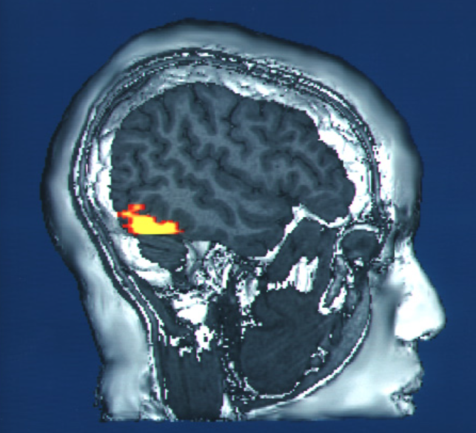
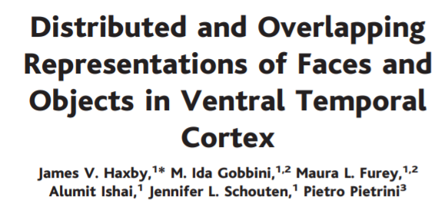
Notes:
In the RR I submitted, I followed the scientific method perfectly – RRs force you to follow it. First, I made the observation that the cortical representation of faces is distributed across the brain rather than localized to one brain area, you can observe this from several previous studies. And yet there is this “Fusiform face Area” or FFA that is considered a highly selective face processing region in the brain.

Slide 19
Why is face representation so distributed in some studies and so localized in others?
Notes:
So why does it seem that face representation is so distributed in some studies and so localized in others? That was my question.

Slide 20
Why is face representation so distributed in some studies and so localized in others?
Faces as a category are represented in object-selective cortex, but specific face identity is represented in FFA
Notes:
My hypothesis was that faces as a category are represented in OSC similarly to objects, but specific face identity like “my mom” is represented in FFA (FFA has also been known to activate for objects of expertise that you know really well, not just faces).

Slide 21
Why is face representation so distributed in some studies and so localized in others?
Faces as a category are represented in object-selective cortex, but specific face identity is represented in FFA
Notes:
So my experiment was to test whether there are representational differences for face identity vs. faces as a category, and compare patterns of activity to object representations

Slide 22
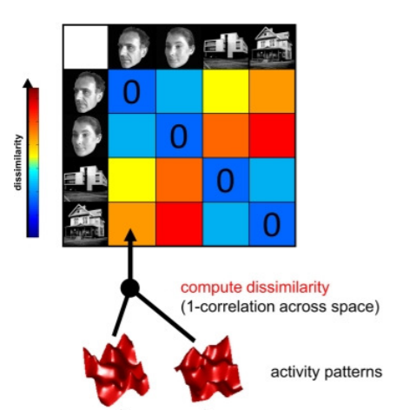
Why is face representation so distributed in some studies and so localized in others?
Kriegeskorte et al, 2008
Faces as a category are represented in object-selective cortex, but specific face identity is represented in FFA
Notes:
I would perform the experiment in an MRI and perform multivariate pattern analysis to find representational differences for those different conditions, and determine if the evidence was in favor or against my hypothesis.

Slide 23
A short history…
How science tends to happen:
SORTA
Notes:
However, we don’t always conduct science in such a linear way, and there are lots of reasons for that I’m not going to go into. But I call this the Sorta Scientific Method

Slide 24
A short history…
How science tends to happen:
THIS WOULD BE A
COOL EXPERIMENT
SORTA
Notes:
Where sometimes you just have a cool idea for an experiment, not based on any observation, just think it would be cool to try out.

Slide 25
A short history…
How science tends to happen:
THIS WOULD BE A
COOL EXPERIMENT
SORTA
WHAT QUESTION COULD I
ANSWER WITH THIS?
Notes:
But“I wonder what would happen” is not really a question

Slide 26
A short history…
How science tends to happen:
THIS WOULD BE A
COOL EXPERIMENT
SORTA
WHAT QUESTION COULD I
ANSWER WITH THIS?
RUN THE STUDY,
FIGURE IT OUT LATER!
Notes:
And it definitely doesn’t lead to any clear or directed hypothesis

Slide 27
A short history…
How science tends to happen:
THIS WOULD BE A
COOL EXPERIMENT
SORTA
WHAT QUESTION COULD I
ANSWER WITH THIS?
LET’S SEE WHAT HAPPENS!
RUN THE STUDY,
FIGURE IT OUT LATER!
Notes:
Often times what happens is, you run the cool experiment

Slide 28
A short history…
How science tends to happen:
THIS WOULD BE A
COOL EXPERIMENT
SORTA
ANALYZE, RINSE, REPEAT
WHAT QUESTION COULD I
ANSWER WITH THIS?
LET’S SEE WHAT HAPPENS!
RUN THE STUDY,
FIGURE IT OUT LATER!
Notes:
Then you’re left with a lot of data. It’s not what you expect because you didn’t expect anything really, and if you discuss the data with your collaborators enough, analyze using method A, then method B, then technique or tool C…

Slide 29
A short history…
How science tends to happen:
THIS WOULD BE A
COOL EXPERIMENT
VOILA, FOUND SOMETHING!
SORTA
ANALYZE, RINSE, REPEAT
WHAT QUESTION COULD I
ANSWER WITH THIS?
LET’S SEE WHAT HAPPENS!
RUN THE STUDY,
FIGURE IT OUT LATER!
Notes:
…eventually something will come out-

Slide 30
A short history…
How science tends to happen:
VOILA, FOUND SOMETHING!
SORTA
ANALYZE, RINSE, REPEAT
WHAT QUESTION COULD I
ANSWER WITH THIS?
LET’S SEE WHAT HAPPENS!
RUN THE STUDY,
FIGURE IT OUT LATER!
Notes:
Then you can write your story around that, come up with a nice little publication. Done!

Slide 31
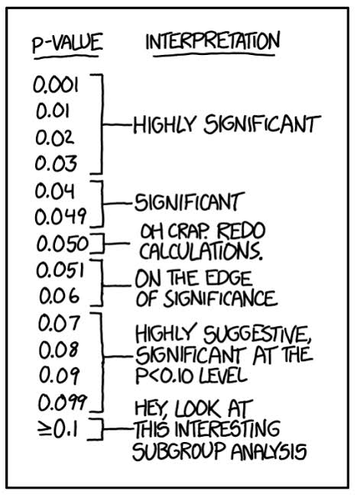
The problem with p values

Slide 32
What is the meaning of a p value?
Mentimeter exercise: https://www.menti.com/k457hs5o9o

Slide 33
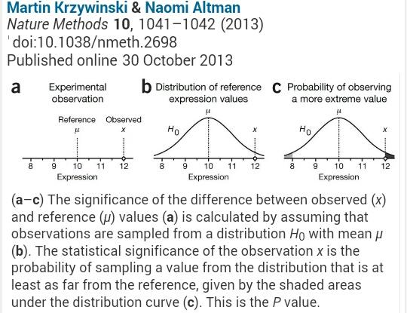

Slide 34
The problem with p values
P values aren’t even that informative, anyway!
You are usually asking if “there is a difference” – not how much of a difference, not whether it is a meaningful difference, predictions are so vague that you set yourself up for finding significance from the beginning
Example:
Creativity training study – do statistically significant assessment scores lead to more creative output? Promotion at work?

Slide 35
What you need to know…
P=0.05, a cutoff frequently used to denote significance, as an arbitrary value that is not evidence-based
The distinction “significant” vs. “non-significant” is a convenience. It does not indicate that a finding should be completely ignored or endorsed
A statistically significant finding is not necessarily “important”; a non-significant finding is not necessarily of no importance
Failing to reject the null hypothesis (e.g., P > 0.05) does not “prove” the null hypothesis is true
P values should always be accompanied by an estimate of effect size and a measure of the estimates’ precision (e.g., SD, SE, or 95% CI)
From Sorkin et al. The American Journal of Clinical Nutrition, Volume 114, Issue 4, October 2021, Pages 1280–1285, https://doi.org/10.1093/ajcn/nqab223

Slide 36
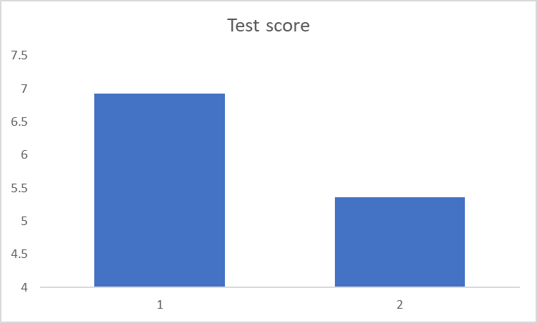
Misleading figures

Slide 37
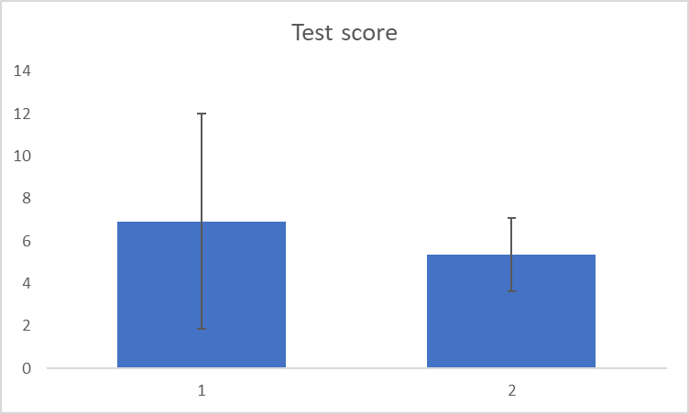
Misleading figures

Slide 38
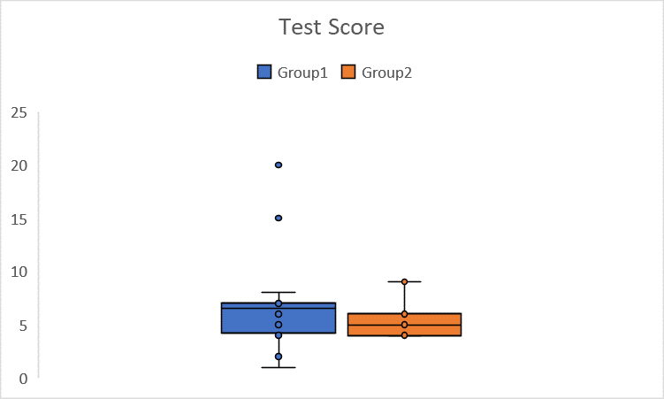
Misleading figures

Slide 39
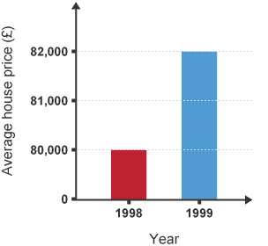
Misleading figures

Slide 40
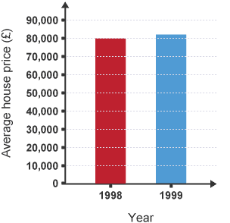
Misleading figures

Slide 41
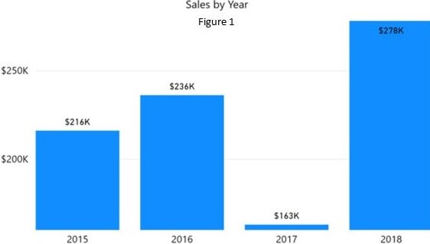
Misleading figures

Slide 42
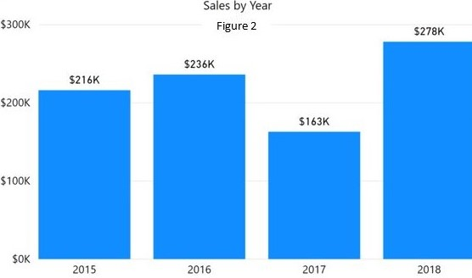
Misleading figures

Slide 43
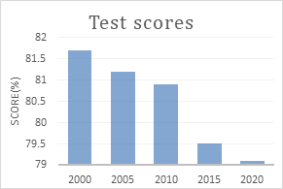
Misleading figures

Slide 44
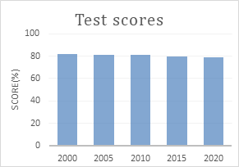
Misleading figures

Slide 45
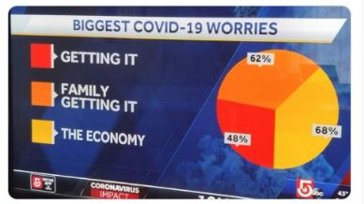
Misleading figures

Slide 46
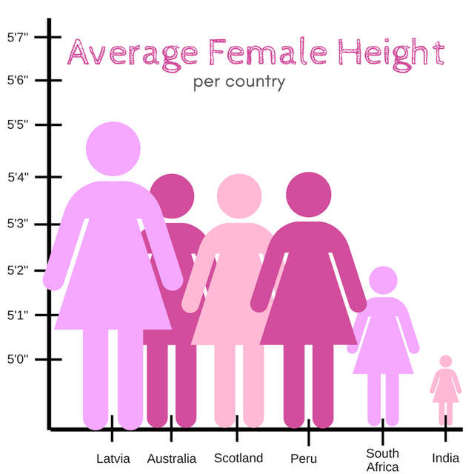
Misleading figures

Slide 47
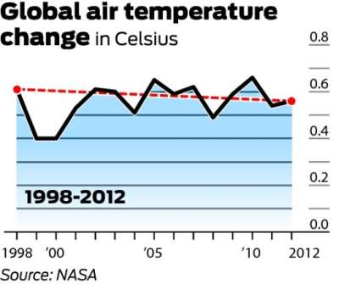
Misleading figures

Slide 48
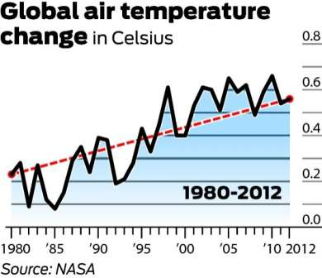
Misleading figures

Slide 49
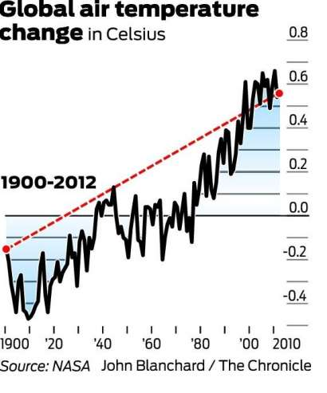
Misleading figures

Slide 50
Misleading figures

Slide 51
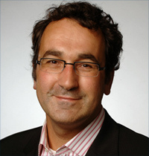
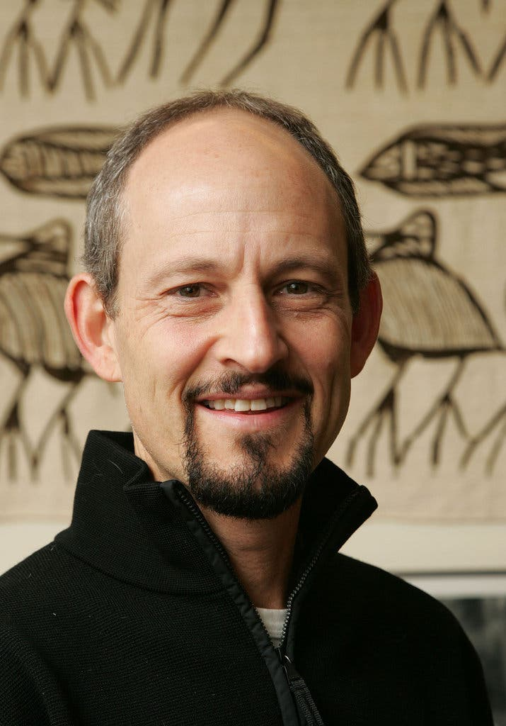
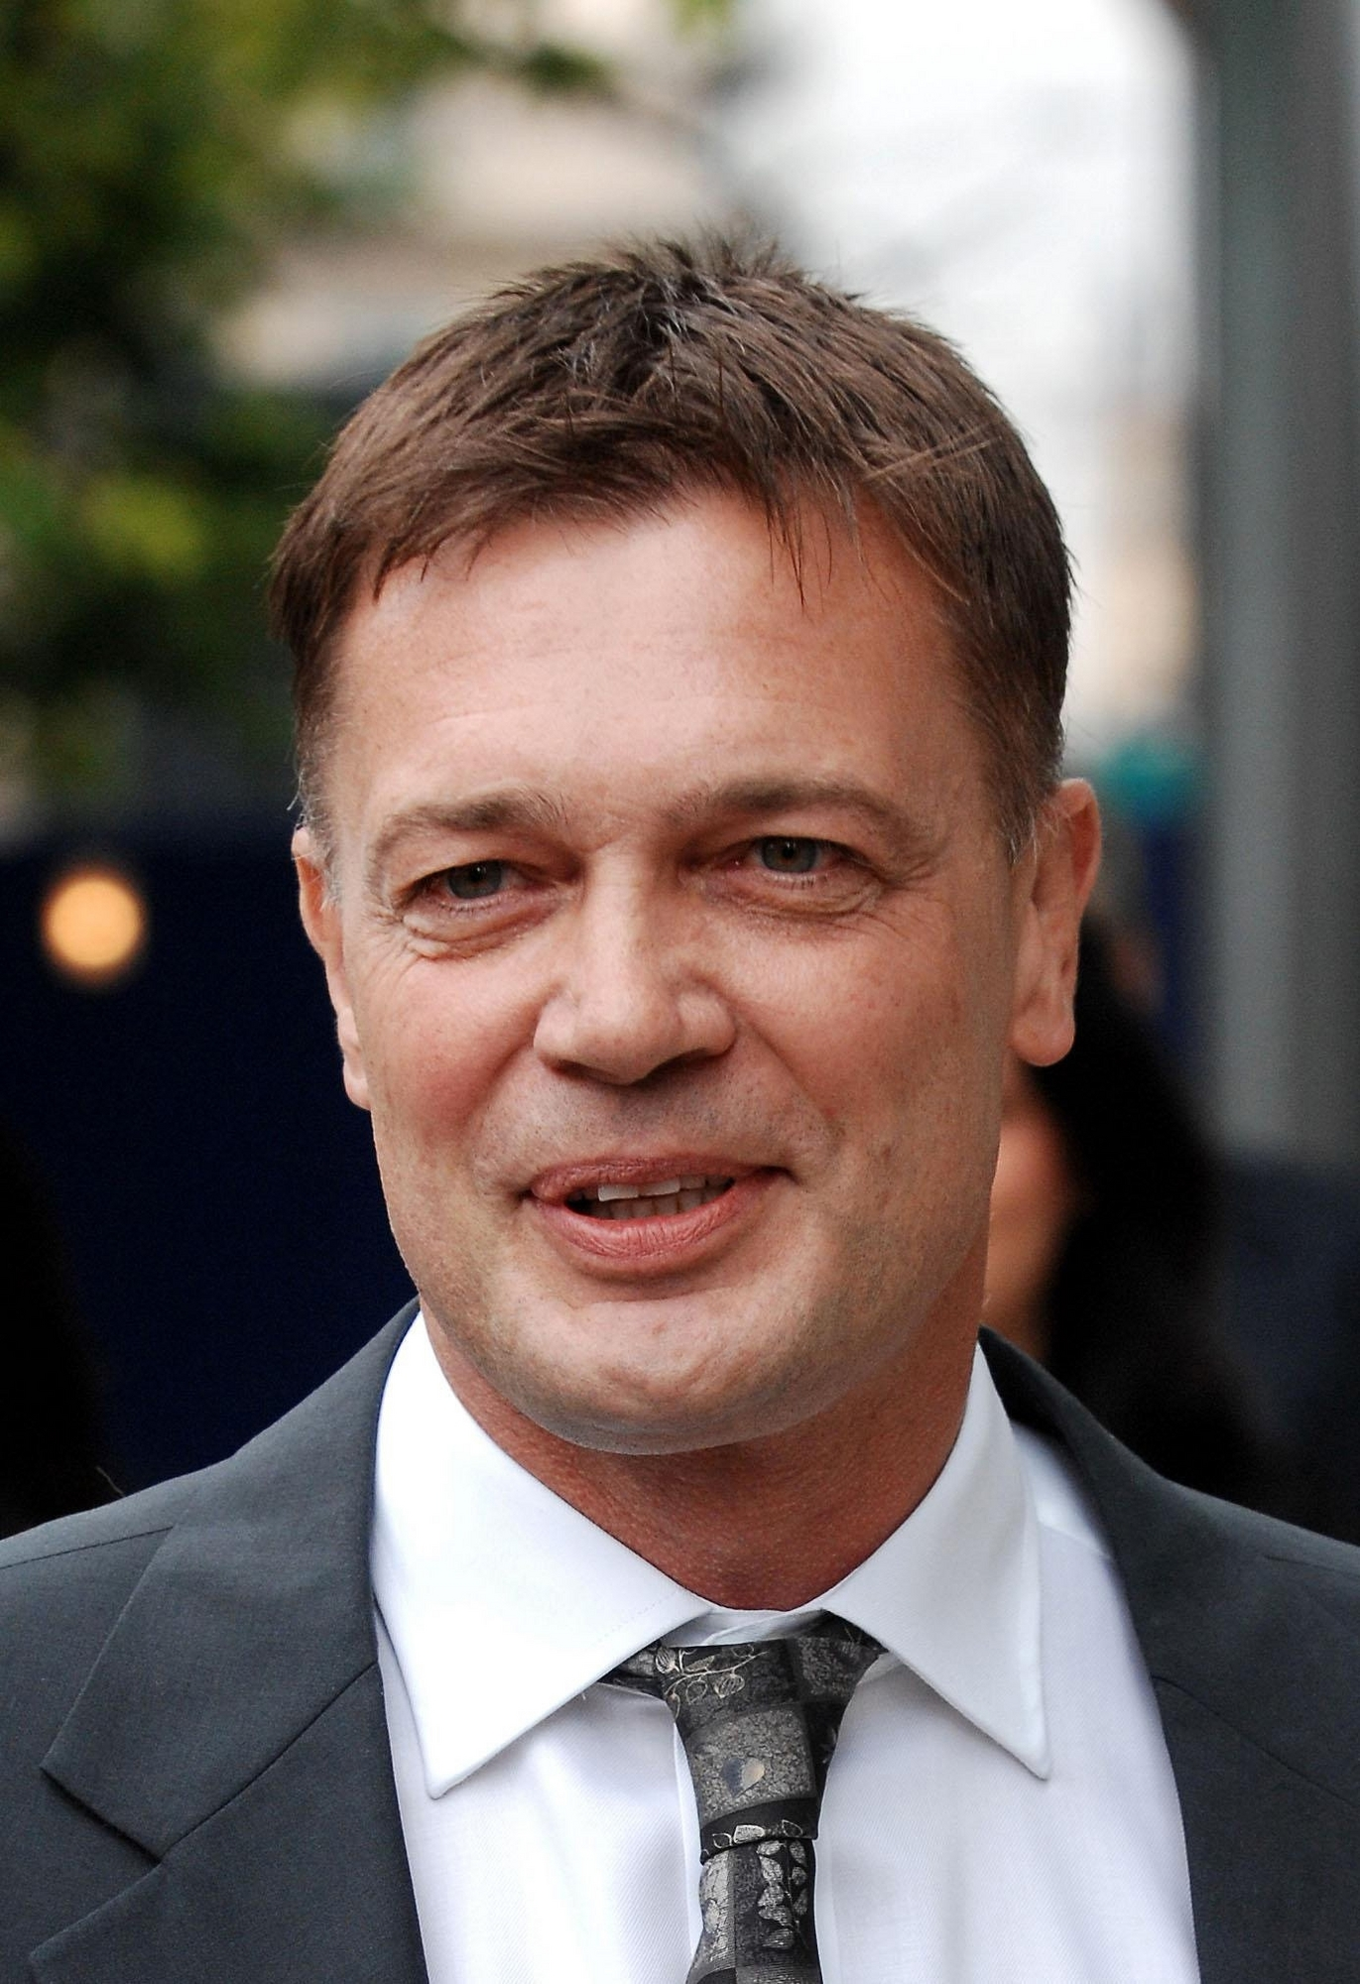
Fraud (can do a case study on one of these)
Diederik Stapel
Marc Hauser
Andrew Wakefield

Slide 52
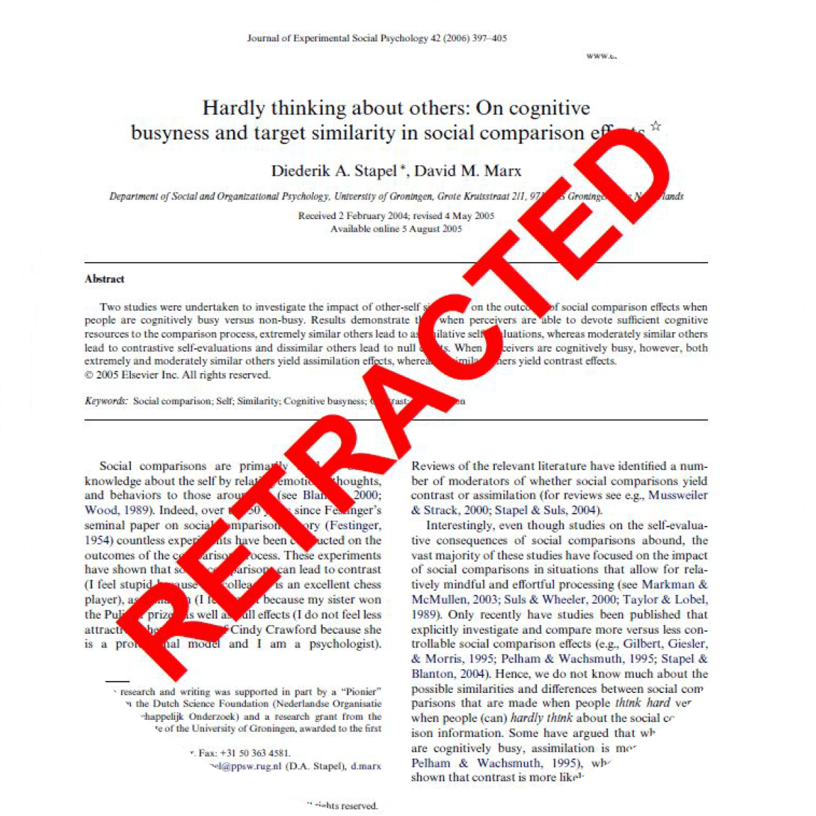
X
X
X
Notes:
I’m going to tell you the cautionary tale of Diedrik Stapel. Diedrik Stapel was a decision making scientist from the Netherlands who climbed the ranks of academic power until he was a professor and dean of behavioral and social science at his university, and also ironically led an anti-fraud committee. His was very famous for studies on social priming, such as finding that seeing clutter in a train station causes you make more conservative political decisions. His PhD students started getting suspicious when he would hand them piles of data to analyze for their research. “Where did you get this data?” his students would say. “Oh, I collected it at the train station over the weekend”, he would respond. “Hundreds of random participants, just analyze it.” Hmm. Students started raising questions and as it turns out, Diedrik had been generating fake data in his own home, just hundreds and hundreds of datasets. 58 of his papers were retracted, he was fired from his job, his PhD was revoked. He wrote a book that tanked and was described as “whiny”, and last I heard he tried to write and star in a play about himself that was canceled before anyone got to see it. In short, don’t be like Diedrik, it will literally ruin your life.

Slide 53
X
X
X

Slide 54
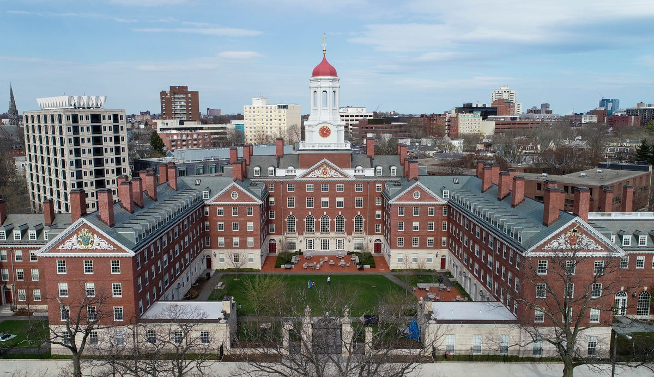
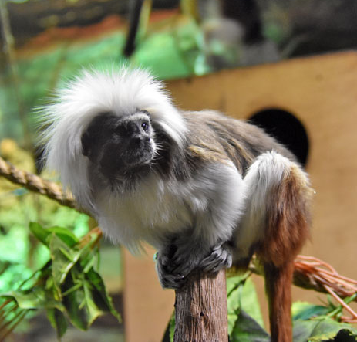
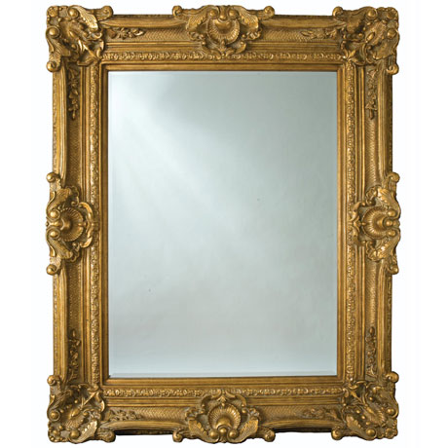
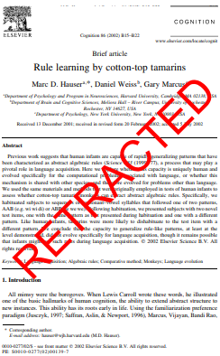
X
X
X
Notes:
Now, for Marc Hauser. Marc Hauser was an evolutionary biologist at Harvard University who studied comparative psychology – that is, he did cognitive psychology experiments with primates and used that information to theorize how certain high-level human cognitive functions may have evolved – such as language and morality. Using primates as models for early humans is not the only use of comparative psychology – more recently, people have been doing studies in primates to determine what they themselves are capable of. Such studies have been supported by animal rights campaigns, as you can imagine – if you can scientifically prove that a monkey has human-like intelligence, then they acquire certain human rights, as you can see from laws passed in Spain and Argentina for the great apes. Marc Hauser was involved in several high profile studies on cognition in primates, one of these being a 1995 study that showed cotton-top tamarins can recognize themselves in a mirror. Mysteriously and suddenly in 2007, Harvard announced an internal investigation into his work. There was no publicity about what sparked this decision, but over the next couple years, many of Marc’s former students came forward, saying he falsely coded videos of monkey behavior, didn’t allow coding by anyone other than himself (usually you have at least 2 independent coders), and his monkey study could not be replicated. However, due to the secrecy of the investigation, plus Harvard ignored statements from former students and research assistants, Hauser was able to argue it wasn’t his fault the mirror study couldn’t replicate and the data had been erased, so there was no way to prove misconduct. This paper was not retracted, but a second one was, on complex pattern learning in the same monkeys. The difference is that the data were available to re-analyze, in which case they found the evidence of misconduct needed to retract. A further 7 papers of his were retracted, plus 4 major grants from public funding, and he was forced to resign from Harvard in 2012.

Slide 55
X
X
X

Slide 56
Notes:
So at this point you might be thinking, OK this looks really bad for the scientific community, but that’s all happening in its own little bubble. How does that affect the real world? Importantly, the last two fraudsters contributed to the rise in public mistrust of science, which is obviously terrible. If the public doesn’t trust scientists, they’re not going to listen to things like climate change warnings, and we are going to have a Don’t Look Up situation on our hands. It’s already happening, and the fraudsters don’t help.

Slide 57
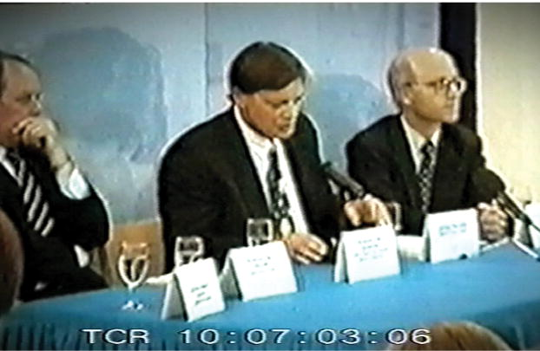
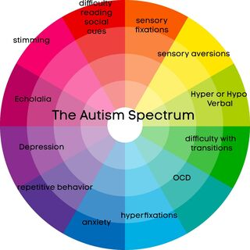
X
MMR
Notes:
Sometimes, the actions of a fraudster have terrible, immediate, and long-lasting real-world consequences. And that’s how we come to Andrew Wakefield. Andrew Wakefield was a physician at the UCL medical school. He came into the public eye when he published reports and papers on 1993 and 1995 about a possible link between the MMR vaccine (which vaccinates against measles mumps and rubella) and Crohn’s disease. Following this, he started looking into the link between the MMR vaccine and autism. In 1998 he published the famous Lancet paper on a link between the MMR vaccine and autism. In this paper, he documented cases of 8 children whose parents claimed they began to experience what was called “regressive autism” within two weeks of receiving the MMR vaccine. That is, previously neurotypical children suddenly started to experience autism symptoms following the vaccine, that progressively became more severe over time. This led to media frenzy, during which Andrew held a press conference urging doctors to seize administering the MMR vaccine until it could be further investigated. This spiraled into an international public health scare. Now at this point you might think, what was his crime exactly? Sensationalizing his research findings? First of all, that alone caused avoidable panic. But in fact, he was guilty of so much more. A former of student of his came forward and said Andrew would ignore data that went against his hypotheses. It later came out that was paid by anti-MMR campaigners to conduct the infamous study, and he recruited parents who already believed the MMR vaccine caused their child’s autism. He conducted invasive medical tests he had neither ethical approval nor the qualifications for. And his findings failed to replicate in several subsequent large scale studies. But maybe he didn’t realize how the public would take the news of his study? Nope, there is even evidence that he planned this MMR scare so that he could capitalize on the public’s fear. Particularly, it came out that two years before he even conducted the study, he filed for a patent on an altered measles vaccine. However, despite losing several lawsuits and a paper retraction in 2010 – more than 10 years after publication – the damage had already been done. Jenny McCarthy, an American TV personality and model, became the spokesperson for the anti-vaxxer movement, which is still in full swing to this day, and likely led to the huge backlash against the COVID vaccine as well.

Slide 58
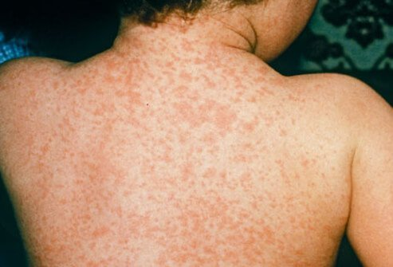
Notes:
So what are the consequences of the anti-vaxxer movement? Let’s take a short interlude to discuss measles. Measles is a viral respiratory disease that typically causes high fever, a hacking cough, and a rash all over the body. Rare but severe symptoms include acute encephalitis or brain swelling, which can cause permanent brain damage. Other severe symptoms include permanent breathing issues, permanent behavioral and intellectual damage. Measles is one of the most contagious disases, and before the 1960s, virtually every child contracted the measles. In the US, each year, millions contracted the virus, 48,000 were hospitalized, 1000 developed permanent disabilities, and 500 died due to measles. Each year, and these stats are only the US.

Slide 59
Notes:
In 1963, a measles vaccine was licensed and in the year 2000, measles was officially eliminated. That means there was not ONE case of measles (endemic to the US) for 12 months prior to 2000. In 1998, there were 56 cases of measles in England and Wales total. Vaccination rates were over 90%.

Slide 60
Notes:
After Andrew Wakefield’s press conference and the MMR scare, cases went through the roof, there was less than 70% vaccination rate, and in 2006 the first child in over a decade died of measles.

Slide 61
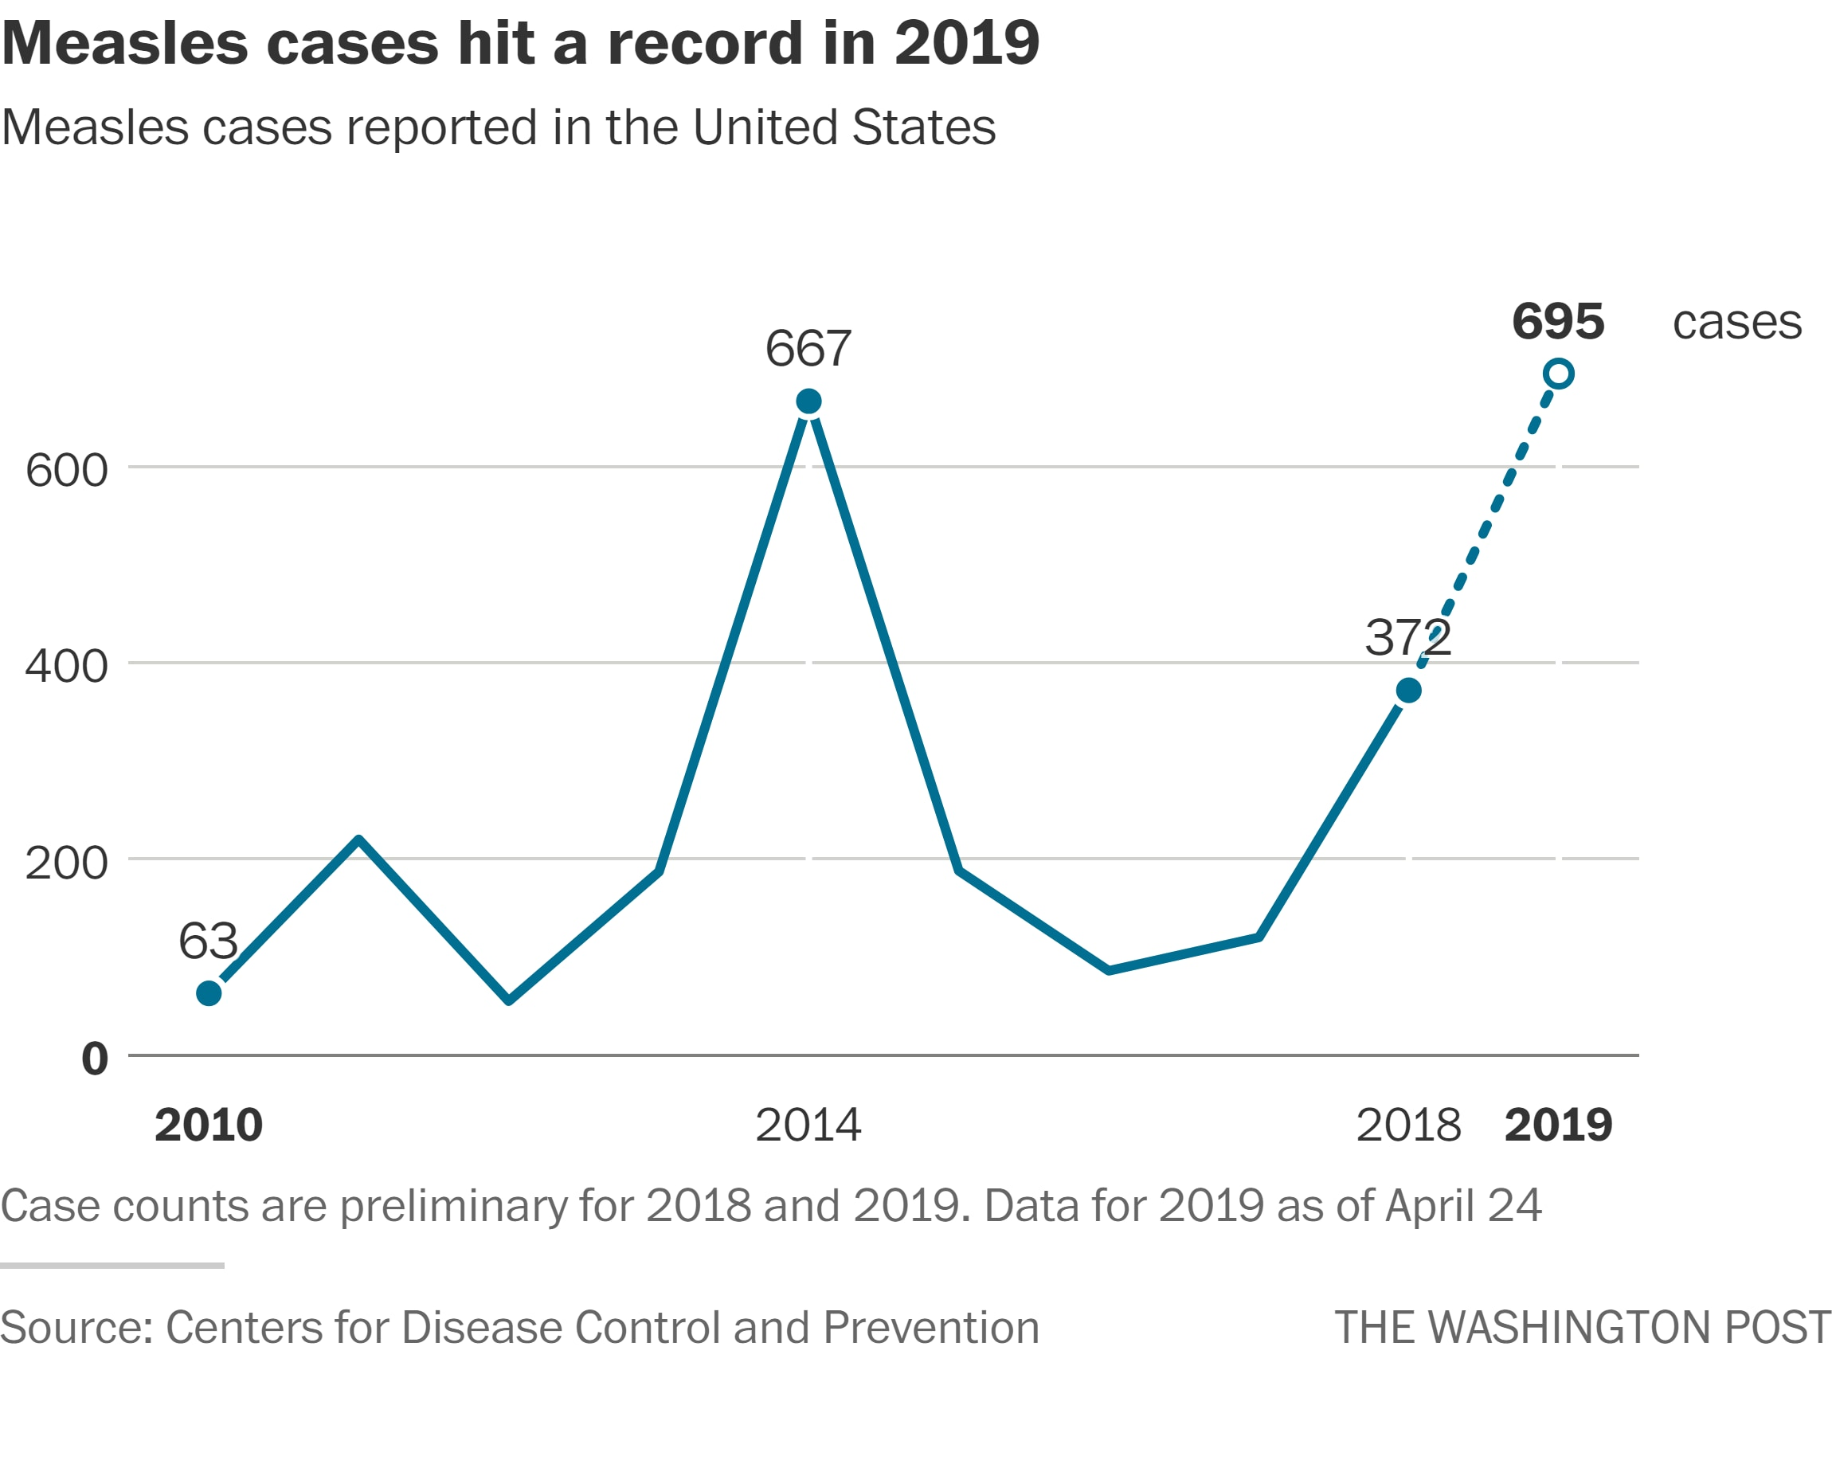
Notes:
Here’s a more recent graph from the US

Slide 62
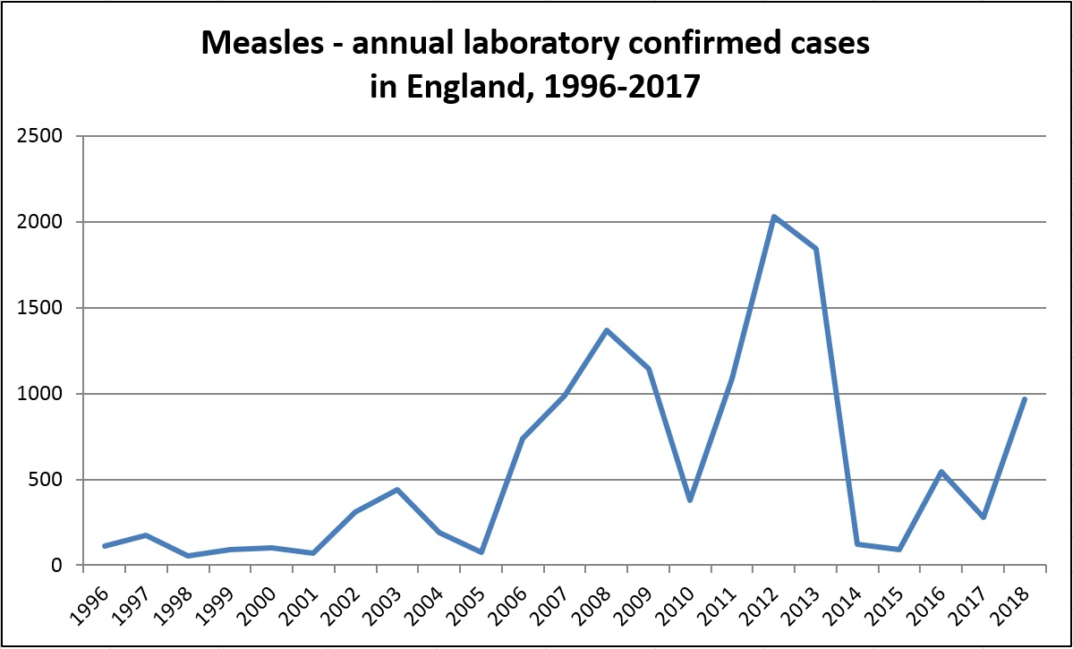
Notes:
And from England. And it also makes you wonder about those parents, who refuse to vaccinate their own children for fear of developing autism. What does that say about the parents? That their fear is so great and pervasive, they would rather let their child contract measles – and risk permanent disability or even death – in the flimsy hope that the child won’t be… autistic.

Slide 63
X
MMR

Slide 64
Summary
Sloppy science
Misunderstanding of statistics
Misguided reporting of data
Outright fraud

Slide 65
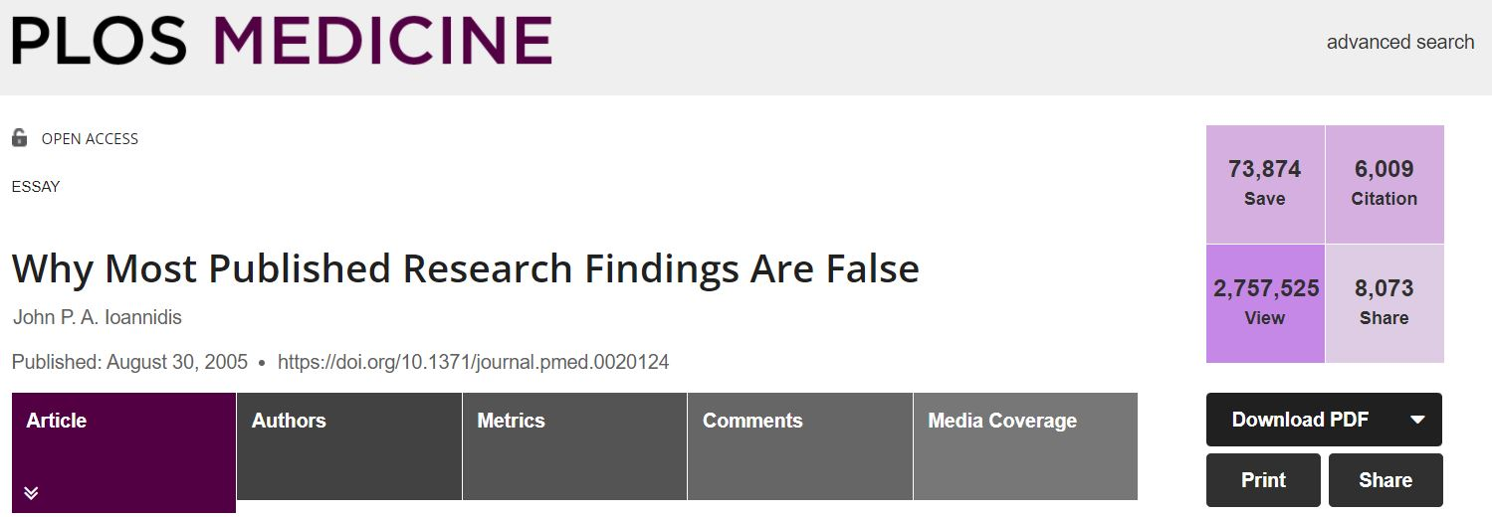
The replication crisis

Slide 66
The replication crisis… what constitutes a lack of replicability?
Failed to find an effect that was claimed in an earlier study
Found an effect that did not exist in an earlier study
The direction of an effect changed
The replication study found a smaller effect than the original study
The replication study found a larger effect than the original study
The statistical evidence in support of an effect was weaker than that claimed by the researchers
From Tim Bock, https://www.displayr.com/what-is-the-replication-crisis/

Slide 67
The replication crisis… the numbers:

Slide 68
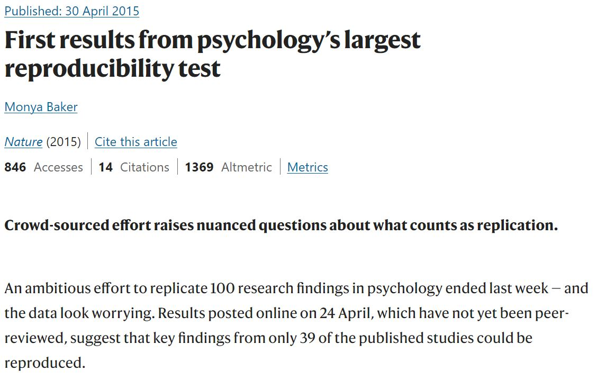
The replication crisis… the numbers:

Slide 69
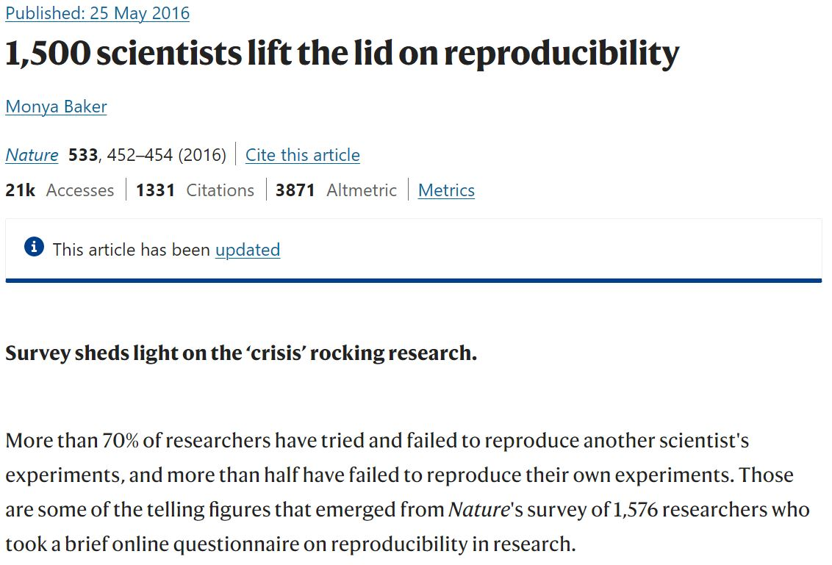
The replication crisis… the numbers:

Slide 70
The replication crisis… the numbers:
From Daniele Fanelli, https://doi.org/10.1371/journal.pone.0005738

Slide 71
The replication crisis… How did this happen?
A widespread lack of methodological sophistication, with researchers using poorly designed experiments with small sample sizes and inappropriate statistical models (Gelman and Carlin, 2014)
The “publish or perish” economic model of universities, which provides an economic incentive for researchers to publish work showing effects
Clerical errors in reporting and programming
Fraud, with research being invented to further career interests or the interests of organizations sponsoring the research
From Tim Bock, https://www.displayr.com/what-is-the-replication-crisis/

Slide 72
The replication crisis… are we doomed?
No!
The solution… coming next week!

Slide 73
Current job opportunities in open science
Open Access Portfolio Manager (Behavioral Sciences)
Employees can work remotely
Full-time
https://jobs.smartrecruiters.com/InformaGroupPlc/743999853229660-open-access-portfolio-manager-behavioral-sciences-
Open Science Lead
Grade: 1 Salary per annum: starting from £49,612
Full Time/Flexible working considered
https://www.cambridgenetwork.co.uk/jobs/open-science-lead
Data and Policy Analyst
Remote (United Kingdom), £40,000
Open Data Services Co-op aims to make open data useful, usable and in-use. We like to work with projects that combine innovation and engagement to deliver sustainable social impact with open data

